Slide 1

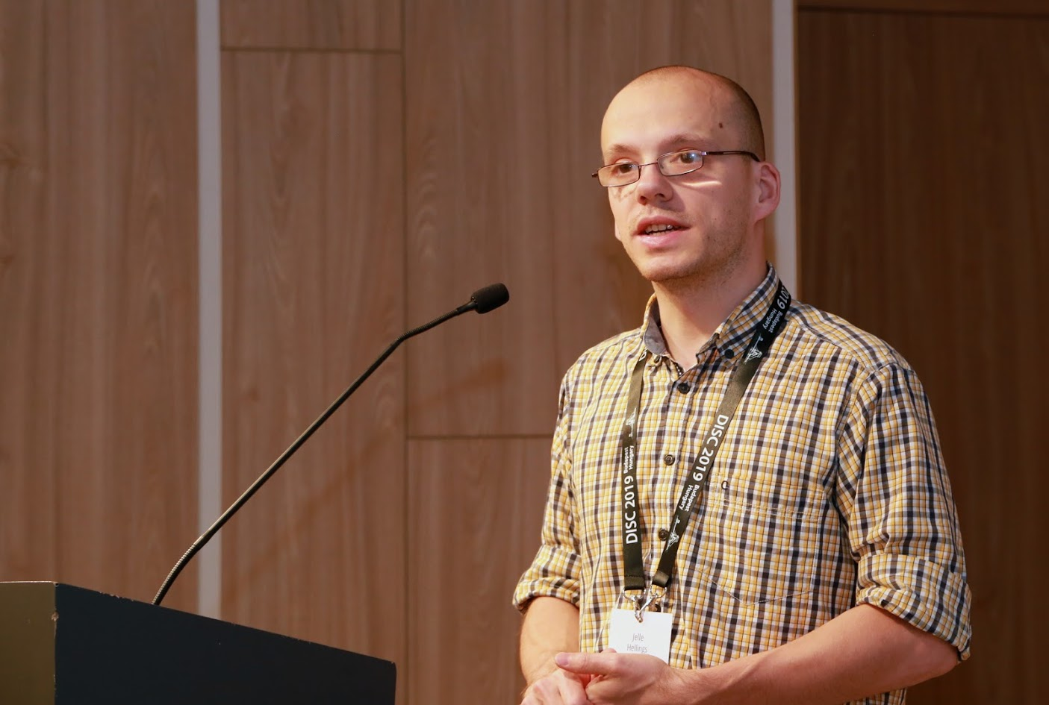



Proof-of-Execution: Reaching Consensus through Fault Tolerant Speculation
Suyash Gupta
Jelle Hellings
Sajjad Rahnama
Mohammad Sadoghi
MokaBlox LLC
Exploratory Systems Lab
University of California Davis

Slide 2



Distributed Databases
Log and Track Records
Book Tickets

Slide 3


Billions of Dollars

Slide 4
Blockchain Technology

Slide 5



Why Blockchain?
Democracy
Decentralization
Authentication
Security

Slide 6
What is Blockchain?
New
Block
Previous
Hash
Genesis
Previous
Hash
Previous
Hash
Data
Data
Data
Client Transactions
Linked List of Blocks
Hash of Previous Block

Slide 7





Blockchain Network

Slide 8





Blockchain: Decentralization → Replicas

Slide 9




Blockchain: Democracy → Vote

Slide 10












Blockchain Applications
Cryptocurrencies
Project Tracking
Waste
Management
Energy Trading
and Management
Healthcare

Slide 11

At the core of any Blockchain application is a Byzantine Fault-Tolerant (BFT) consensus protocol.
OK
OK
Order Txn
OK

Slide 12



First practical BFT implementation.
Practical Byzantine Fault Tolerance (PBFT)
Client
T
Primary
Replica 1
Replica 2
Byzantine
Client
Request
Pre-Prepare
O(n)
Prepare
O(n²)
Commit
O(n²)
Reply
Execute
Two Phases of O(n²)!!!
Consensus among n replicas & at most f byzantine → n >= 3f+1
n = 4 replicas and f <= 1

Slide 13

Requirements of Existing BFT Protocols
Multiple phases of quadratic communication (PBFT).
Expect no failures or dependence on clients (Zyzzyva).
Incur high client latencies (HotStuff).

Slide 14
Speculative Execution
Proof-of-Execution (PoE)
Three-phase Linear protocol
Out-of-Order Message Processing
No dependence on clients or trusted component.

Slide 15
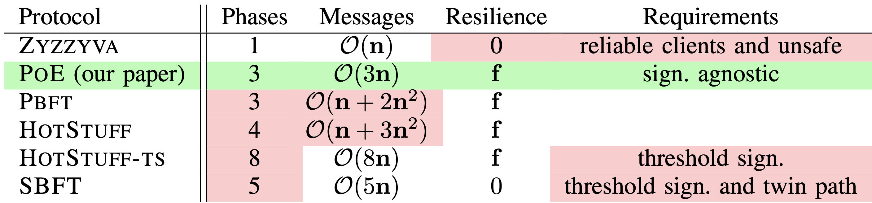
PoE vs Other Protocols

Slide 16
Proof-of-Execution (PoE)
Client
T
Primary
Replica 1
Replica 2
Byzantine
Replica
Client
Request
Pre-Prepare
Prepare
Certify
Reply
Execute
n = 4 replicas and f <= 1

Slide 17
Magical Ingredient → Client Commit implies Finality
If client receives n-f responses → Transaction will persist in time.
Replicas may be required to rollback.

Slide 18
How to replace a malicious Primary?
New Primary
Replica 1
Replica 2
Byzantine
Primary
View Change Request
Join after Receiving
f+1 VC requests
New View
Propose
Enter
New View

Slide 19
ResilientDB: High Throughput Yielding, Scalable Permissioned Blockchain Fabric*
Visit at: https://resilientdb.com/
*Proceedings of the 40th IEEE ICDCS 2020.

Slide 20
Can a well-crafted system based on a classical BFT protocol outperform a modern protocol?

Slide 21
ResilientDB Architecture
SECURE
LAYER
EXECUTION LAYER
THREADS
SIGNING
TOOLKIT
QUEUES
NET WORK
HASHING
TOOLKIT
BFT CONSENSUS
STORAGE LAYER
METADATA
BLOCKCHAIN

Slide 22
Implementation on ResilientDB
Network
Network
REPLICA
Client
Requests
Batching
Input
Output
Message from
Clients and Replicas
Message to
Replicas or Clients
Execute
Worker
Prepare & Commit
messages
ResilientDB associates a multi-threaded deep-pipelined architecture with each replica.

Slide 23
Evaluating PoE on ResilientDB

Slide 24
Evaluation Metrics
Google cloud used for deploying replicas and clients.
Each replica used 16-core Intel Xeon Cascade Lake CPUs and had access to 32 GB memory.
Total 320K clients deployed on 16 machines.
Workload provided by Yahoo Cloud Serving Benchmark (YCSB).
Experiments ran for 180s → First 60s warmup.

Slide 25
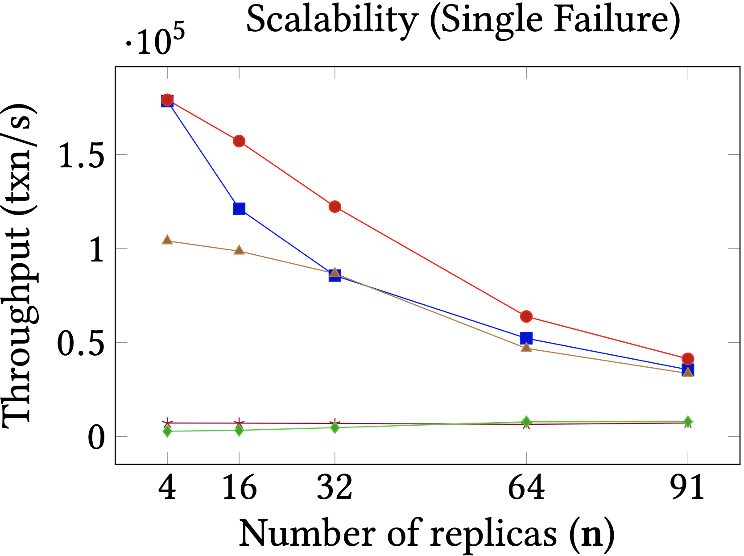
Scalability

Slide 26
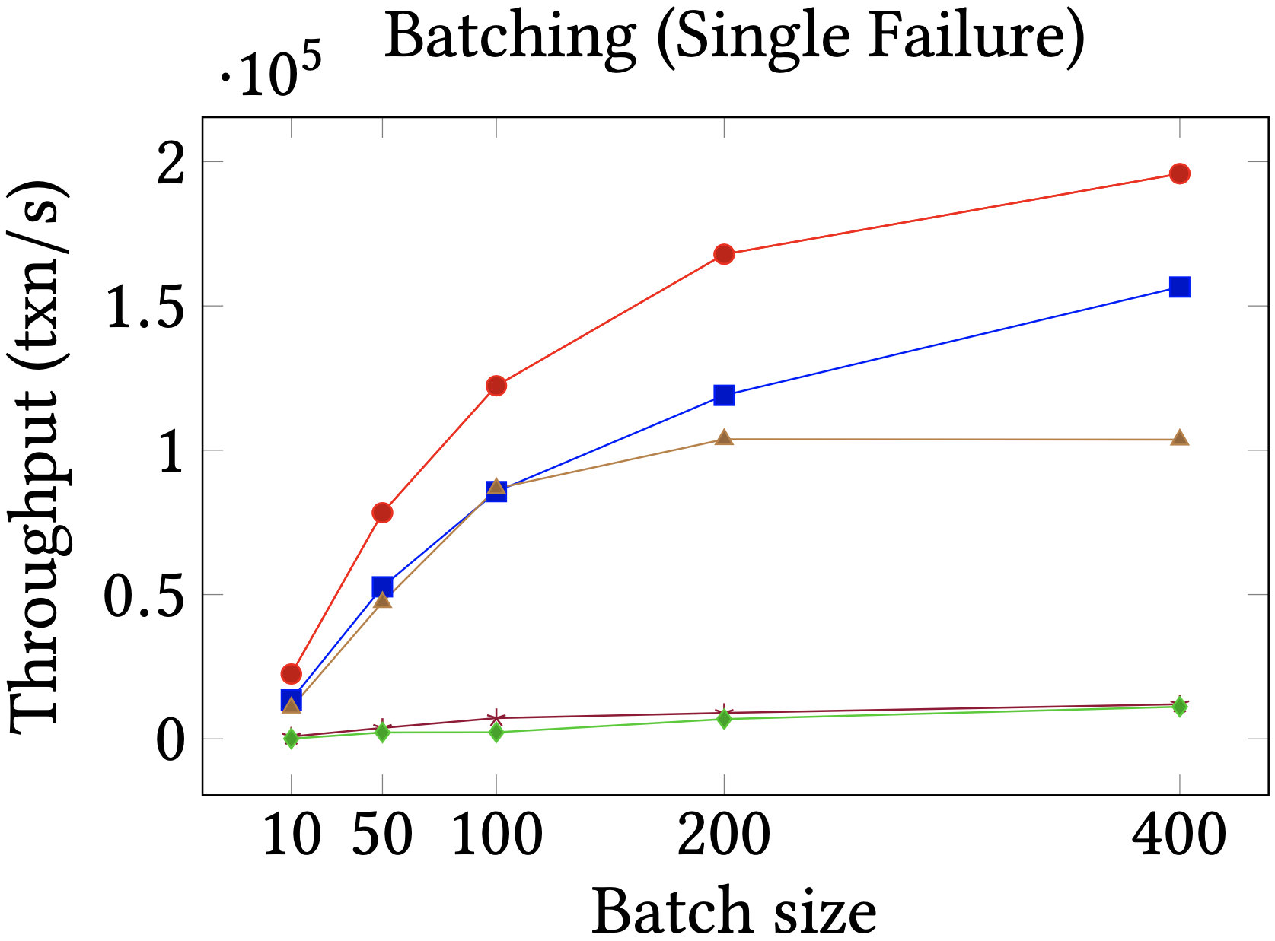
Batching

Slide 27
Conclusions and Final Remarks
PoE achieves consensus in three linear phases.
PoE employs Speculative Execution and Out-of-order Message Processing.
If client commits → Transaction persists in time.
Replicas may be required to rollback their state.
PoE supports a two-phase MAC variant (details in paper).

Slide 28
Thank You

